Slide 1
Applied AI
Lecture 4
Dr Artie Basukoski
[slides adapted from Artificial Intelligence: A Modern Approach, Russel and Norvigl]

Slide 2
Agenda
Games – Adversarial Search
The AI Behind Deep Blue (Beat World Chess champion ’97)
Minimax algorithm
Alpha beta pruning (α–β pruning)
Limiting depth
Games of Chance
Imperfect Information

Slide 3
Types of games
Deterministic and stochastic
One, two, or more players
Zero sum or cooperative?
Perfect information games (you can see the whole state)
Need an Algorithm to calculate next move at each state.

Slide 4
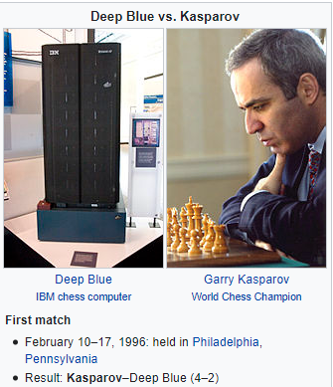

The AI Behind Deep Blue

Slide 5
Games vs. search problems
“Unpredictable” opponent ⇒ solution is a strategy specifying a move for every possible opponent reply
Time limits ⇒ unlikely to find goal, must approximate History:
Computer considers possible lines of play (Babbage, 1846)
Algorithm for perfect play (Zermelo, 1912; Von Neumann, 1944)
Shannon, 1950)
First chess program (Turing, 1951)
Machine learning to improve evaluation accuracy (Samuel, 1952–57)
Pruning to allow deeper search (McCarthy, 1956)
Chapter 6

Slide 6
Types of games
 | Deterministic | Chance
Perfect Information | Chess,checkers, go, Othello | Backgammon, monopoly
Imperfect Information | Battleships, blind tictactoe | Bridge, poker, scrabble, nuclear war
Chapter 6

Slide 7
2 player zero-sum games
The games most commonly studied within AI
Deterministic
2 player (we call the two players Max and Min)
Turn taking
Perfect information
Zero-sum games
(means what is good for one player is bad for the other)
Max and Min each compete to find a sequence of actions leading to a win.
Such as TicTacToe, Chess and Go

Slide 8
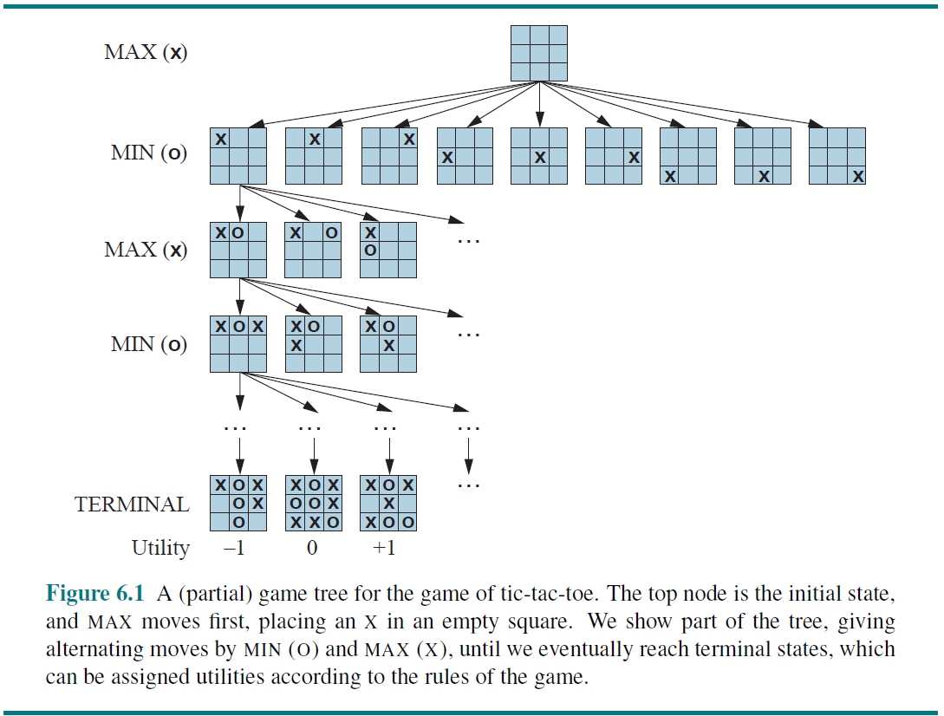
Game tree (2-player, deterministic, turns)
Chapter 6

Slide 9
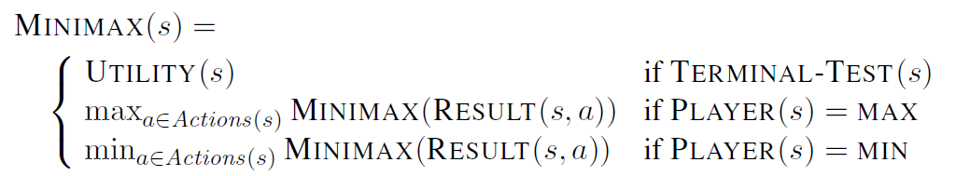
Minimax overview
S0: The initial state, which specifies how the game is set up at the start.
PLAYER(s): Defines which player has the move in a state.
ACTIONS(s): Returns the set of legal moves in a state.
RESULT(s, a): The transition model, which defines the result of a move.
TERMINAL-TEST(s): A terminal test, which is true when the game is over and false otherwise. States where the game has ended are called terminal states.
UTILITY(s, p): A utility function (also called an objective function or payoff function), defines the final numeric value for a game that ends in terminal state s for a player p.

Slide 10
Minimax
Perfect play for deterministic, perfect-information games
Idea: choose move to position with highest minimax value
= best achievable payoff against best play
E.g., 2-ply game:
MAX
3
A ₁
A ₂
A ₃
MIN
3
2
2
^{A} 11 ^{A} 12 ^{A} 13
^{A} 21 ^{A} 22
^{A} 23
^{A} 31 ^{A} 32 ^{A} 33
3
12 8 2 4 6 14 5
2
Chapter 6
Notes:
Triangle pointing up means it is Max’s move and Max wants to maximise the value from the child nodes.
Triangle pointing down means it is Min’s and Minn wants to minimize the value of the child nodes.
A1 A2 are the actions. Values are shown on each node.
Take a moment to study what is happening here.
Minimax of root = the max of the mins.

Slide 11
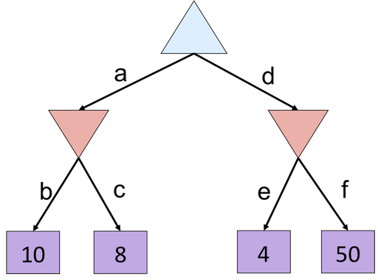
Quiz

Slide 12
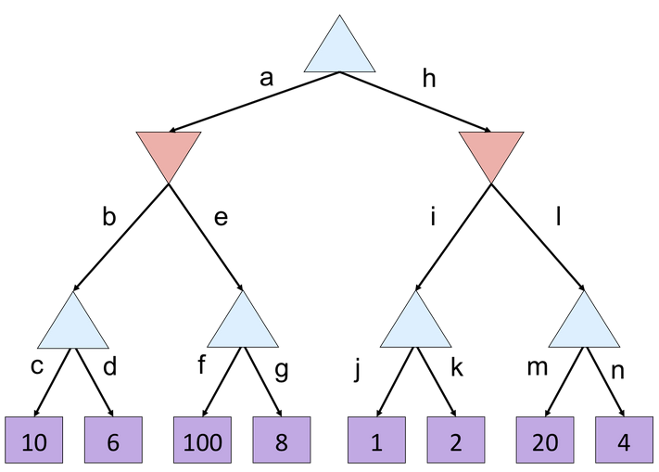
Quiz 2

Slide 13
Minimax algorithm
function Minimax-Decision(state) returns an action
inputs: state, current state in game
return the a in Actions(state) maximizing Min-Value(Result(a, state))
function Max-Value(state) returns a utility value
if Terminal-Test(state) then return Utility(state)
v ← −∞
for a, s in Successors(state) do v ← Max(v, Min-Value(s))
return v
function Min-Value(state) returns a utility value
if Terminal-Test(state) then return Utility(state)
v ← ∞
for a, s in Successors(state) do v ← Min(v, Max-Value(s))
return v
Chapter 6

Slide 14
Properties of minimax
Complete: Yes, if tree is finite (chess has specific rules for this)
Optimal: Yes, against an optimal opponent. Otherwise?? Time complexity: O(b^{m})
Space complexity: O(bm) (depth-first exploration) For chess, b ≈ 35, m ≈ 100 for “reasonable” games
⇒ exact solution completely infeasible
But do we need to explore every path?
Chapter 6

Slide 15
α–β pruning
The problem with minimax search is that the number of game states it has to examine is exponential and the depth of the tree.
We can’t eliminate the exponent, but we can reduce it by half (on average).
α–β pruning can eliminate leaves and entire subtrees.
α is Max’s best value on path to root
β is Min’s best value on path to root
Pruning has no effect on the minimax value computed for the root.
Branches that were pruned would have wasted time without being relevant to the search.

Slide 16
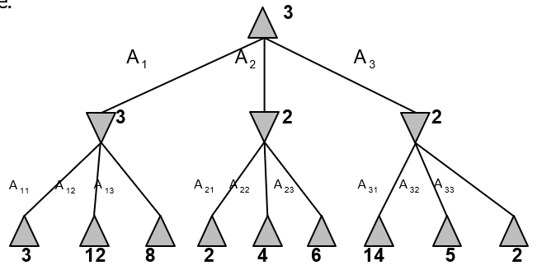
α–β pruning example
MAX
3
MIN
3
3
12 8
Chapter 6 – page 199

Slide 17
α–β pruning example
MAX
3
MIN
3
2
X X
3
12 8 2
Chapter 6 – page 199

Slide 18
α–β pruning example
MAX
3
MIN
3
2
14
X X
3
12 8 2
14
Chapter 6 – page 199

Slide 19
α–β pruning example
MAX
3
MIN
3
2
14 5
X X
3
12 8 2
14 5
Chapter 6 – page 199

Slide 20
α–β pruning example
MAX
3 3
MIN
3
2
14 5 2
X X
3
12 8 2
14 5
2
Chapter 6 – page 199

Slide 21
The α–β algorithm
function Alpha-Beta-Decision(state) returns an action
return the a in Actions(state) maximizing Min-Value(Result(a, state))
function Max-Value(state, α, β) returns a utility value
inputs: state, current state in game
α, the value of the best alternative for max along the path to state
β, the value of the best alternative for min along the path to state
if Terminal-Test(state) then return Utility(state)
v ← −∞
for a, s in Successors(state) do
v ← Max(v, Min-Value(s, α, β)) ; Max of all min values
if v ≥ β then return v ; Prune: Min will not choose value > beta
α ← Max(α, v)
return v
function Min-Value(state, α, β) returns a utility value
same as Max-Value but with roles of α, β reversed
Chapter 6

Slide 22
Quiz

Slide 23
Properties of α–β
Pruning does not affect final result
Good move ordering improves effectiveness of pruning With “perfect ordering,” time complexity = O(b^{m/2})
⇒ doubles solvable depth
A simple example of the value of reasoning about which computations are relevant (a form of metareasoning)
Unfortunately, 35⁵⁰ is still impossible!
Chapter 6

Slide 24
Resource limits – Limiting depth
Standard approach:
Use Cutoff-Test instead of Terminal-Test
e.g., depth limit
Use Eval instead of Utility
i.e., evaluation function that estimates desirability of position
Suppose we have 100 seconds, explore 10⁴ nodes/second
⇒ 10⁶ nodes per move ≈ 35^{8/2}
⇒ α–β reaches depth 8 ⇒ pretty good chess program
Chapter 6

Slide 25















Evaluation functions
Black to move
White slightly better
White to move
Black winning
For chess, typically linear weighted sum of features:
Eval(s) = w₁f₁(s) + w₂f₂(s) + . . . + w_{n}f_{n}(s)
e.g., w₁ = 9 with
f₁(s) = (number of white queens) – (number of black queens),
Chapter 6

Slide 26
Deterministic games in practice
Checkers: Chinook ended 40-year-reign of human world champion Marion Tinsley in 1994. Used an endgame database defining perfect play for all positions involving 8 or fewer pieces on the board, a total of 443,748,401,247 positions.
Chess: Deep Blue defeated human world champion Gary Kasparov in a six- game match in 1997. Deep Blue searches 200 million positions per second, uses very sophisticated evaluation, and undisclosed methods for extending some lines of search up to 40 ply.
Othello: human champions refuse to compete against computers, who are too good.
Go: human champions refused to compete against computers before 2017, because they were too bad!! In go, b > 300, so most programs used pattern knowledge bases to suggest plausible moves before deep learning changed the game.
Chapter 6

Slide 27

Nondeterministic games: backgammon
0 1 2 3 4 5 6 7 8 9 10 11 12
25 24 23 22 21 20 19 18 17 16 15 14 13
Chapter 6

Slide 28
Nondeterministic games in general
In nondeterministic games, chance is introduced by dice, card-shuffling
Simplified example with equal chance of two outcomes:
MAX
CHANCE
3
−1
0.5
0.5
0.5
0.5
MIN
2
4
0
−2
2 4 7 4 6 0 5 −2
Chapter 6

Slide 29
Algorithm for nondeterministic games
Expectiminimax gives perfect play
Just like Minimax, except we must also handle chance nodes:
. . .
if state is a Max node then
return the highest ExpectiMinimax-Value of Successors(state)
if state is a Min node then
return the lowest ExpectiMinimax-Value of Successors(state)
if state is a chance node then
return average of ExpectiMinimax-Value of Successors(state)
. . .
Chapter 6

Slide 30
Games of imperfect information
E.g., card games, where opponent’s initial cards are unknown
Typically we can calculate a probability for each possible deal
Seems just like having one big dice roll at the beginning of the game Idea: compute the minimax value of each action in each deal,
then choose the action with highest expected value over all deals
Point is that each game needs to have carefully considered heuristics and techniques
Bridge programs approximate this idea by
generating 100 deals consistent with bidding information
picking the action that wins most tricks on average
Chapter 6

Slide 31
Games in practice
Computers have reached world standards in many games
QUACKLE program defeated the former world champion in Scrabble. Libratus took on four of the top poker players in the world in a 20-day match of no limit Texas hold ’em and decisively beat them all. Pluribus beat 5 simultaneous players Texas hold ‘em.
TDGammon uses depth-2 search + very good Eval is world-champion level. Led to advances in the theory of correct backgammon play.
Even Video Games such as Starcraft II. In 2019, Vinyals and DeepMind team AlphaStar program based on deep learning and reinforcement learning defeated expert gamers 10-1.
Chapter 6

Slide 32
Summary
Games are fun to work on! (and dangerous, eg MAD)
They illustrate several important points about AI
perfection is unattainable ⇒ must approximate
good idea to think about what to think about
uncertainty constrains the assignment of values to states
optimal decisions depend on information state, not real state Games are to AI as grand prix racing is to automobile design
Chapter 6

Slide 33
Questions or comments

